Slide 1


Open Search
Garvit Kumar Gupta
Under The Guidance of
Mr. Supratim Sen & Mr. Sundar Srinivasan

Slide 2

Objective
OpenSearch setup for CSE
cloud as a replacement for ELK
2

Slide 3
Agenda
OpenSearch
Tenant
Saved Objects
Ingest Pipeline
File beat
Dashboard
&
Visualization
User , Roles
&
Roles Mapping
Summary

Slide 4

OpenSearch
The Apache 2.0-licensed search, analytics, and visualization suite with advanced security, alerting, SQL support, automated index management, etc.
4

Slide 5
Why OpenSearch?
Robust security
Built-in integrations
Quickly deployed
&
Easily managed
Highly scalable
Open source API support
5

Slide 6
OpenSearch Use Case
Log analytics
Clickstream analytics
Enterprise Search
Real-time application monitoring
6

Slide 7
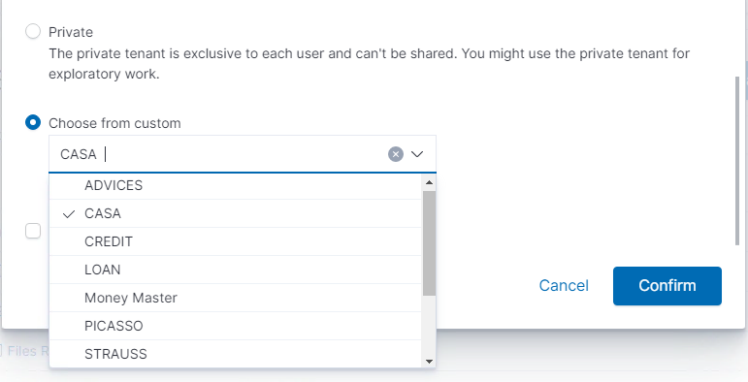
Tenants
Allow you to organize our saved objects into meaningful categories.
Useful for safely sharing our work with other OpenSearch Dashboards users.
Fig: Tenants I created using API (Currently in CASA)
7

Slide 8
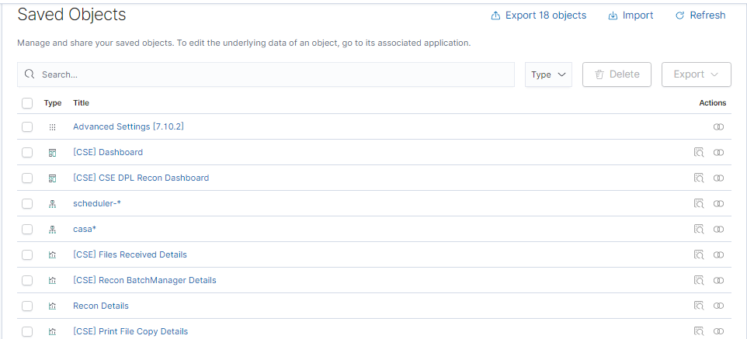
Saved Objects
These objects store data for later use, including dashboards, visualizations, maps, data views, Canvas work pads, and more.
Fig: Saved Objects in CASA Tenant
8

Slide 9
Ingest Pipelines
Incoming
Documents
Ingest pipelines let us perform common transformations on our data before indexing.
We can use pipelines to remove fields, extract values from text, and enrich your data.
Ingest Pipeline
Grok
Convert
Target Index
9

Slide 10
Processors
Set
Split
Each processor runs sequentially
Makes specific changes to incoming documents
Then OpenSearch adds the transformed documents to the index
Grok
Convert
Script

Slide 11

Filebeat
a lightweight shipper
monitors the log files
collects log events
forwards them to OpenSearch
beats
11

Slide 12
How To Push Logs To OpenSearch
Input
Filter
Output
File Beat
Ingest Pipeline
OpenSearch
12

Slide 13
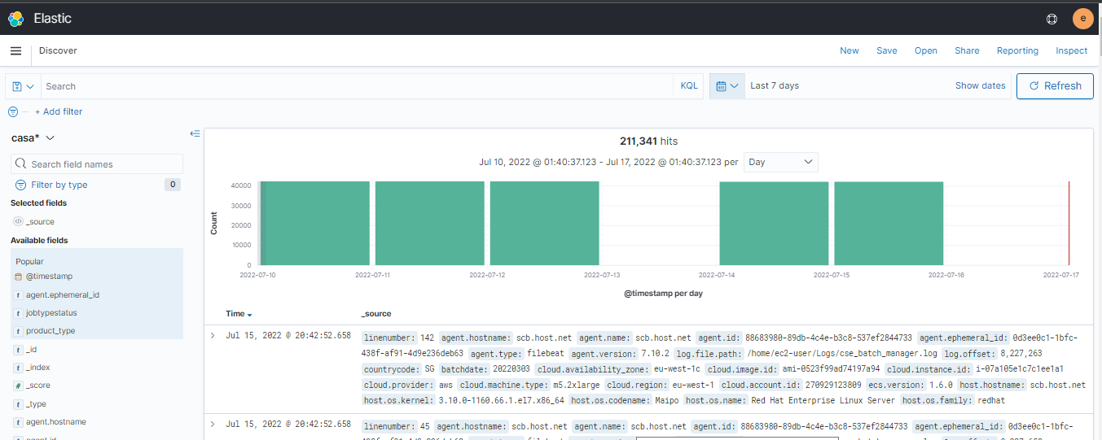
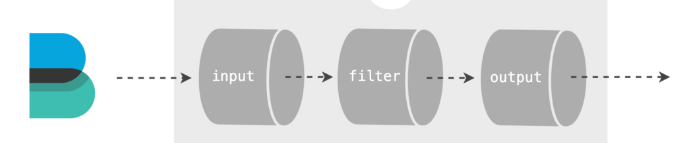
Discover
File Beat
Ingest Pipeline
OpenSearch
13

Slide 14
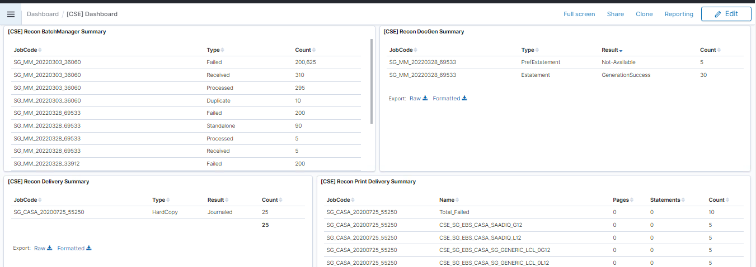
Dashboard
turn our data from one or more data views into a collection of panels
bring clarity to our data
tell a story about our data
focus on only the important data
Fig: [CSE] Dashboard in CASA Tenant
14

Slide 15
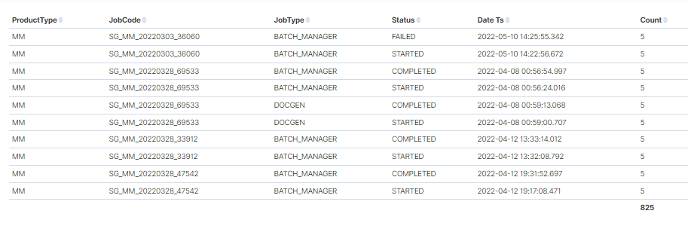
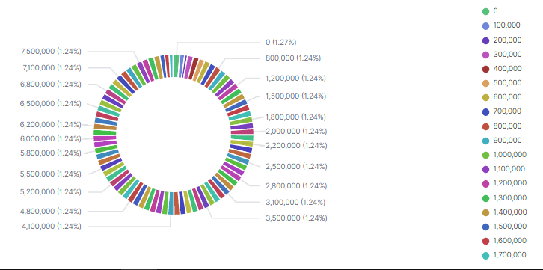
Visualizations
15

Slide 16
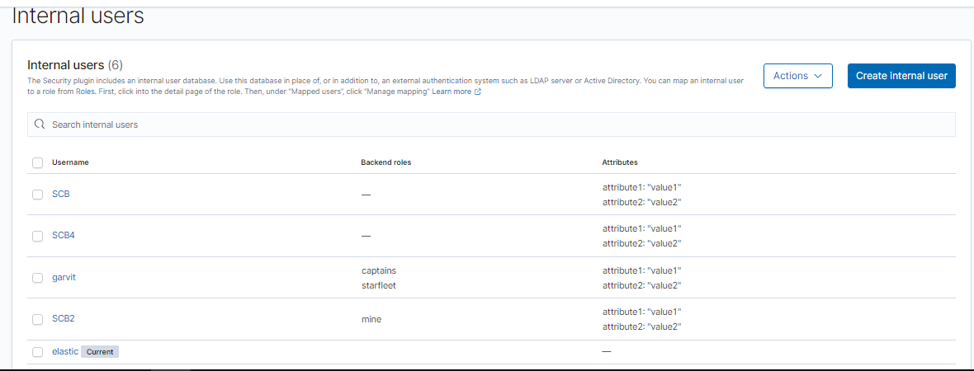
Users
Fig: All internal users (Current user is elastic)
16

Slide 17
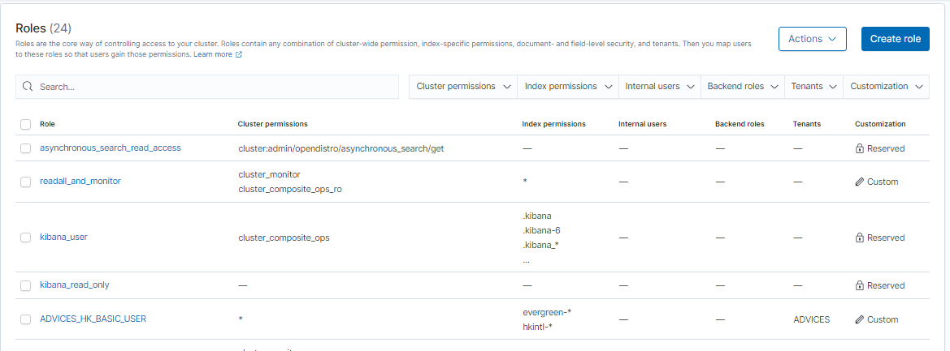
Roles & Roles Mapping
Roles are the core way of controlling access to your cluster.
Roles contain any combination of cluster-wide permissions, index-specific permissions, document- and field-level security, and tenants.
Then we can map users to these roles so that users gain those permissions.
Fig: Roles in OpenSearch
17

Slide 18
Challenges
Learning new Tech in a short period of time
No detailed explanation for OpenSearch APIs
Occasional Crashes of VDI
18

Slide 19






Source and References
19

Slide 20


Summary
OpenSearch has been set up and configured for the CSE cloud as a replacement for the ELK platform.
OpenSearch enables us to easily ingest, secure, search, aggregate, view, and analyze data.
Various tenants and saved objects have been created for this purpose.
Ingest pipelines have been created to preprocess the incoming documents.
Roles have been also mapped to the various users using Open search APIs.
20

Slide 21




Thank you

